Slide 1
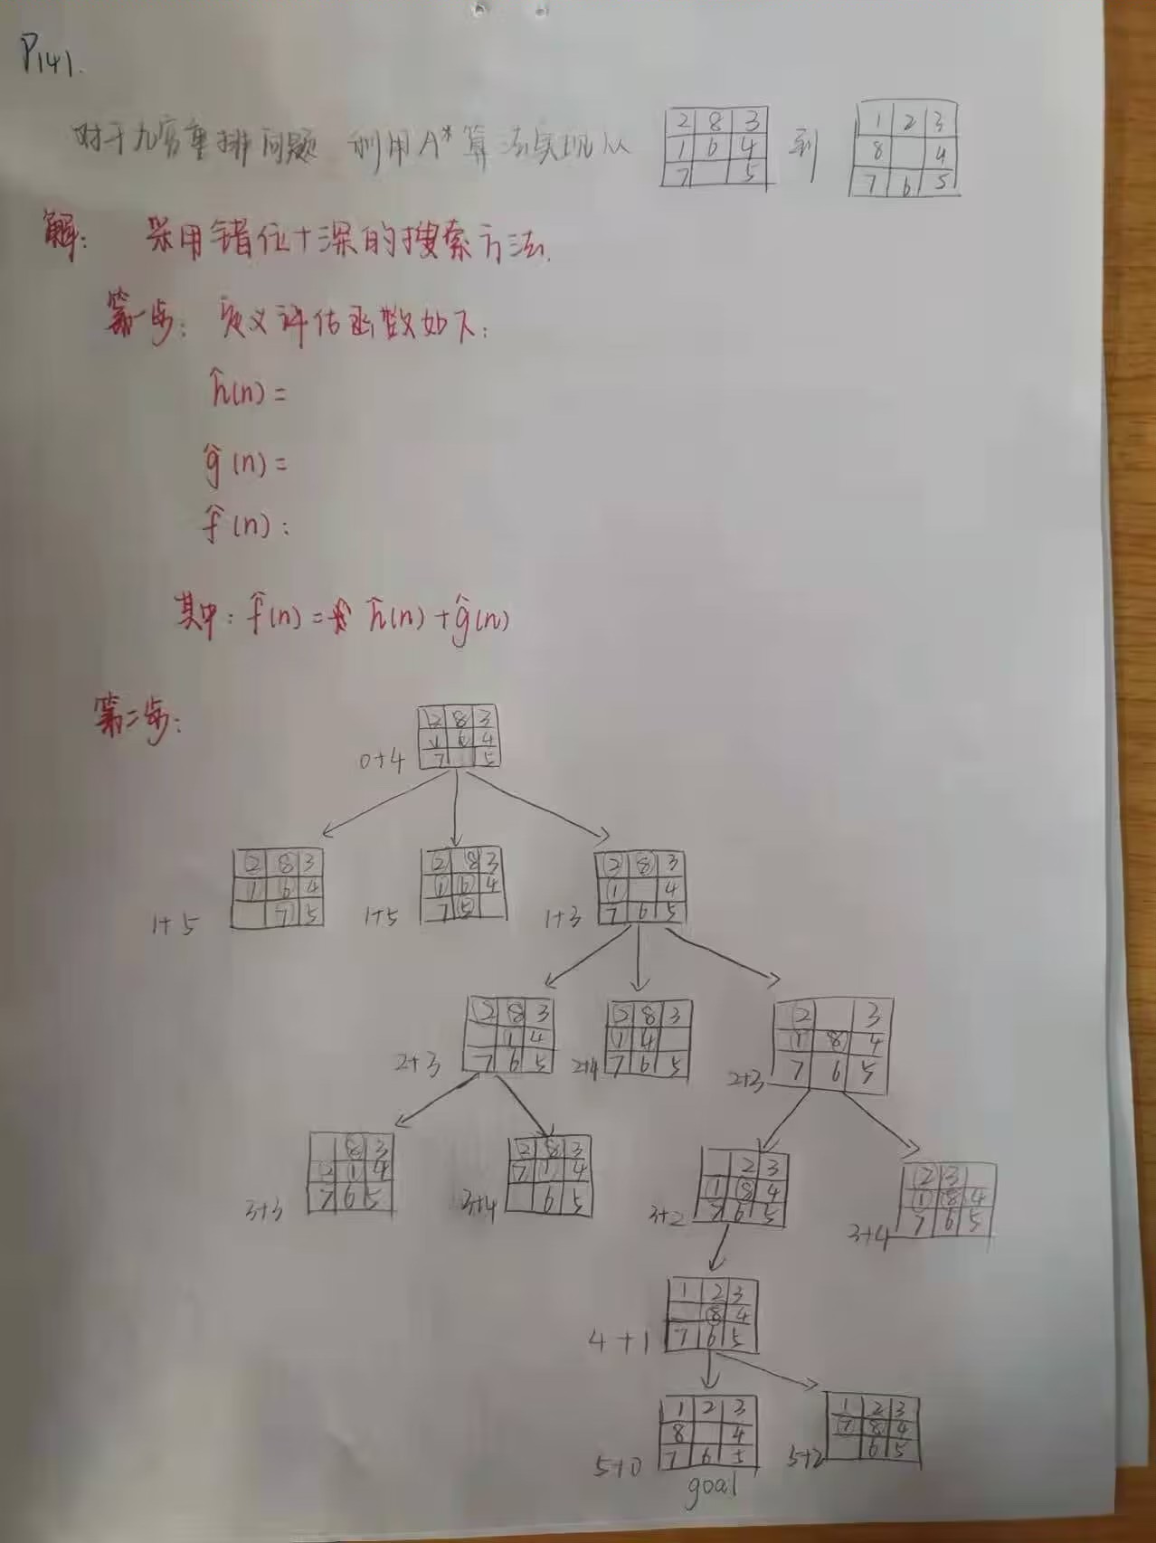

Slide 2
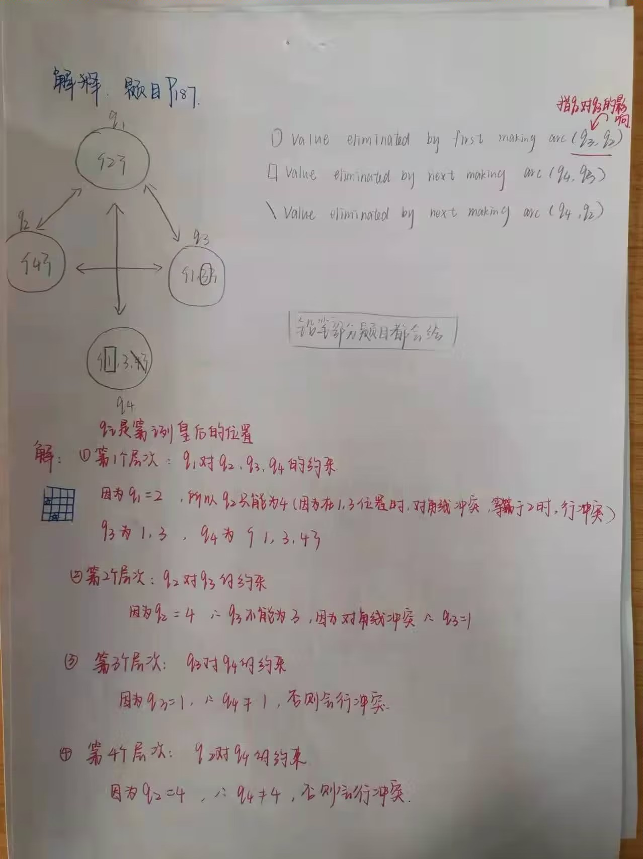

Slide 3
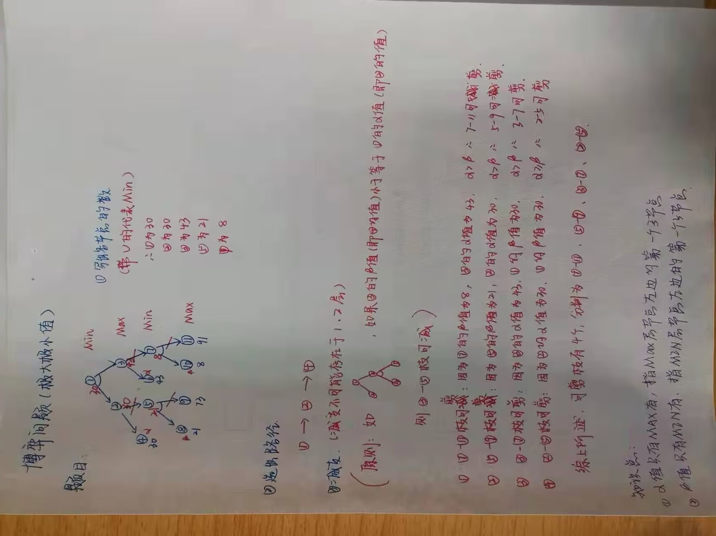

Slide 4
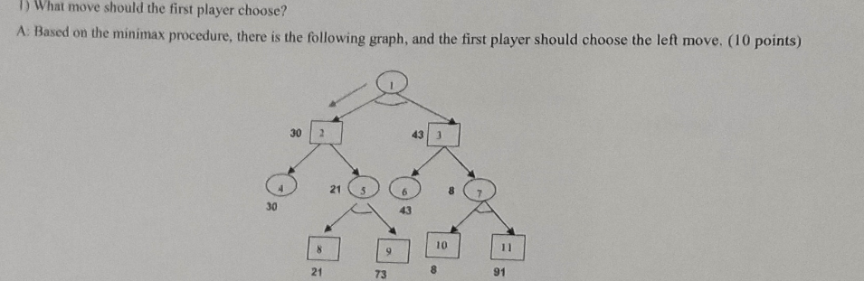
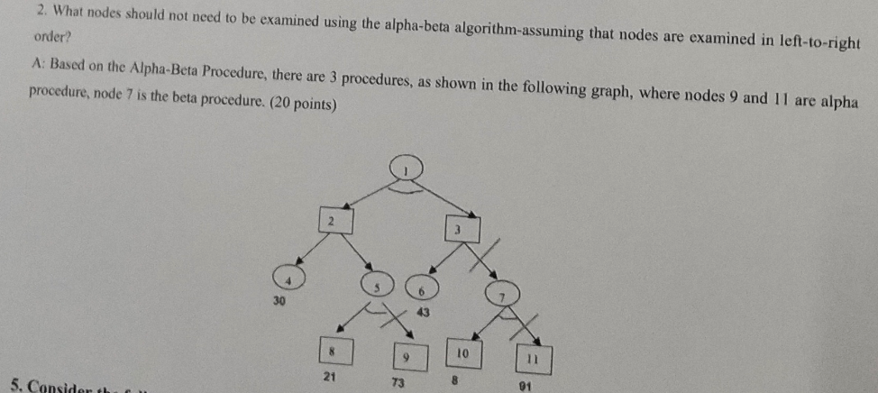

Slide 5
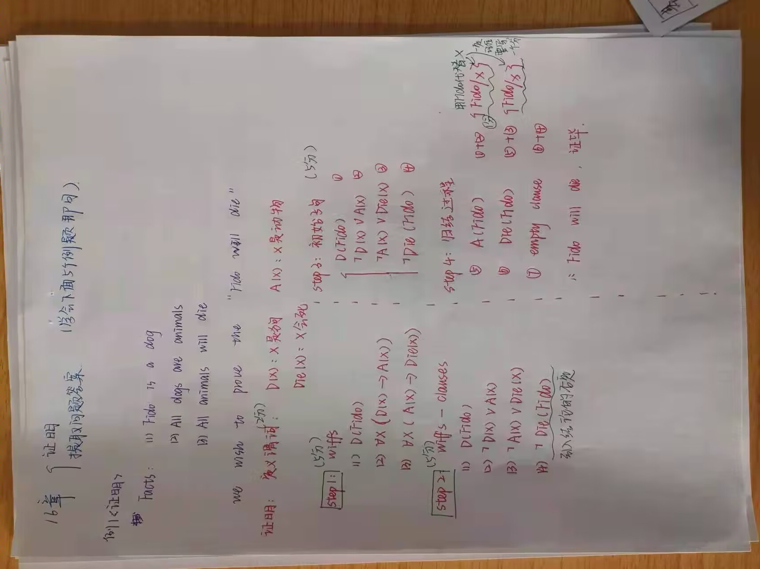

Slide 6
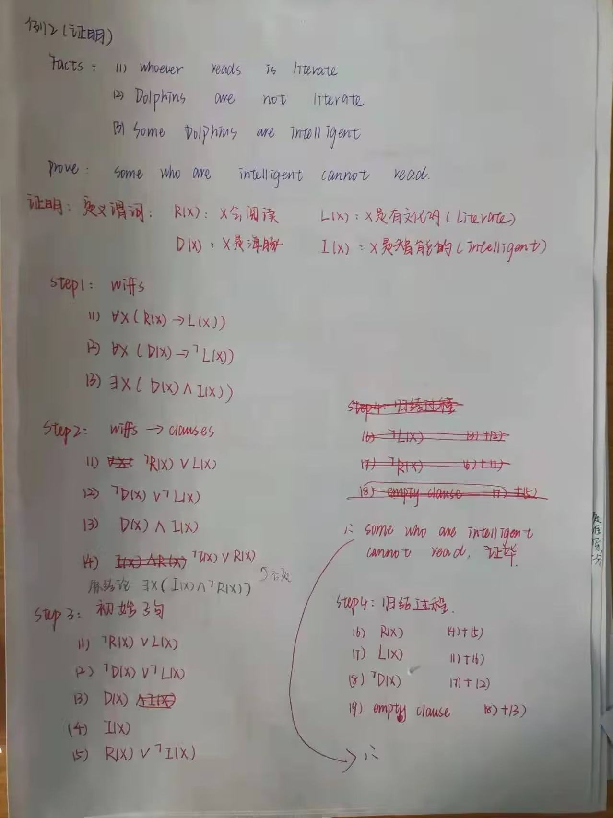

Slide 7
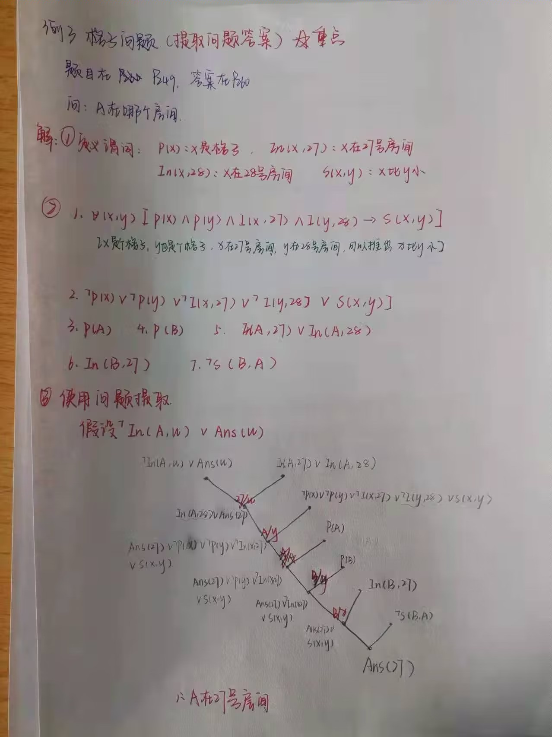

Slide 8
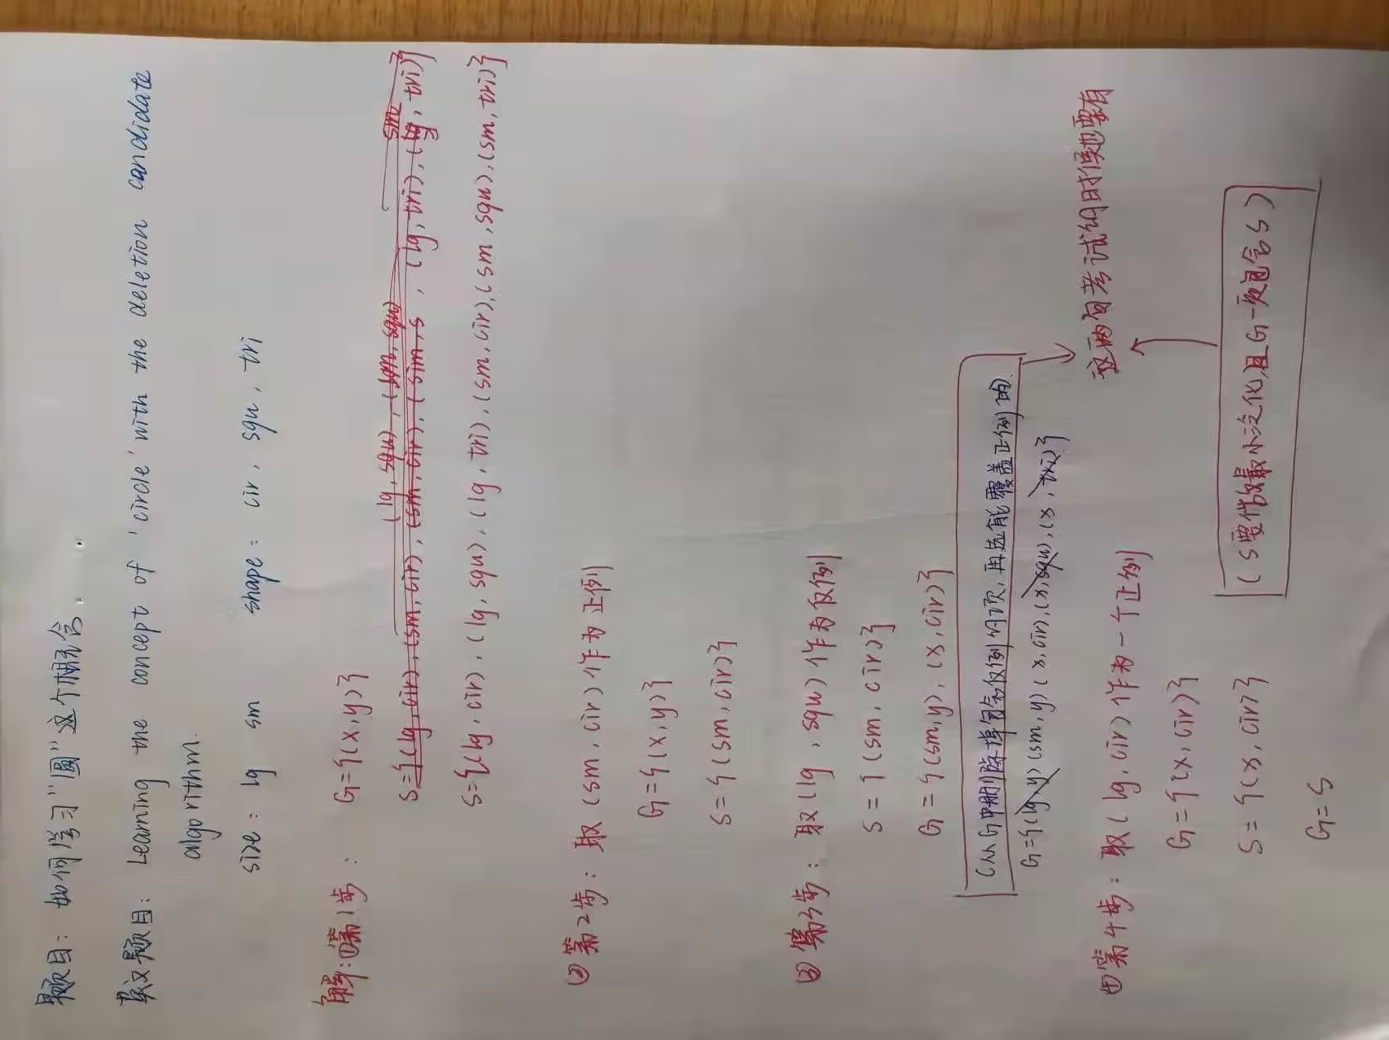

Slide 9
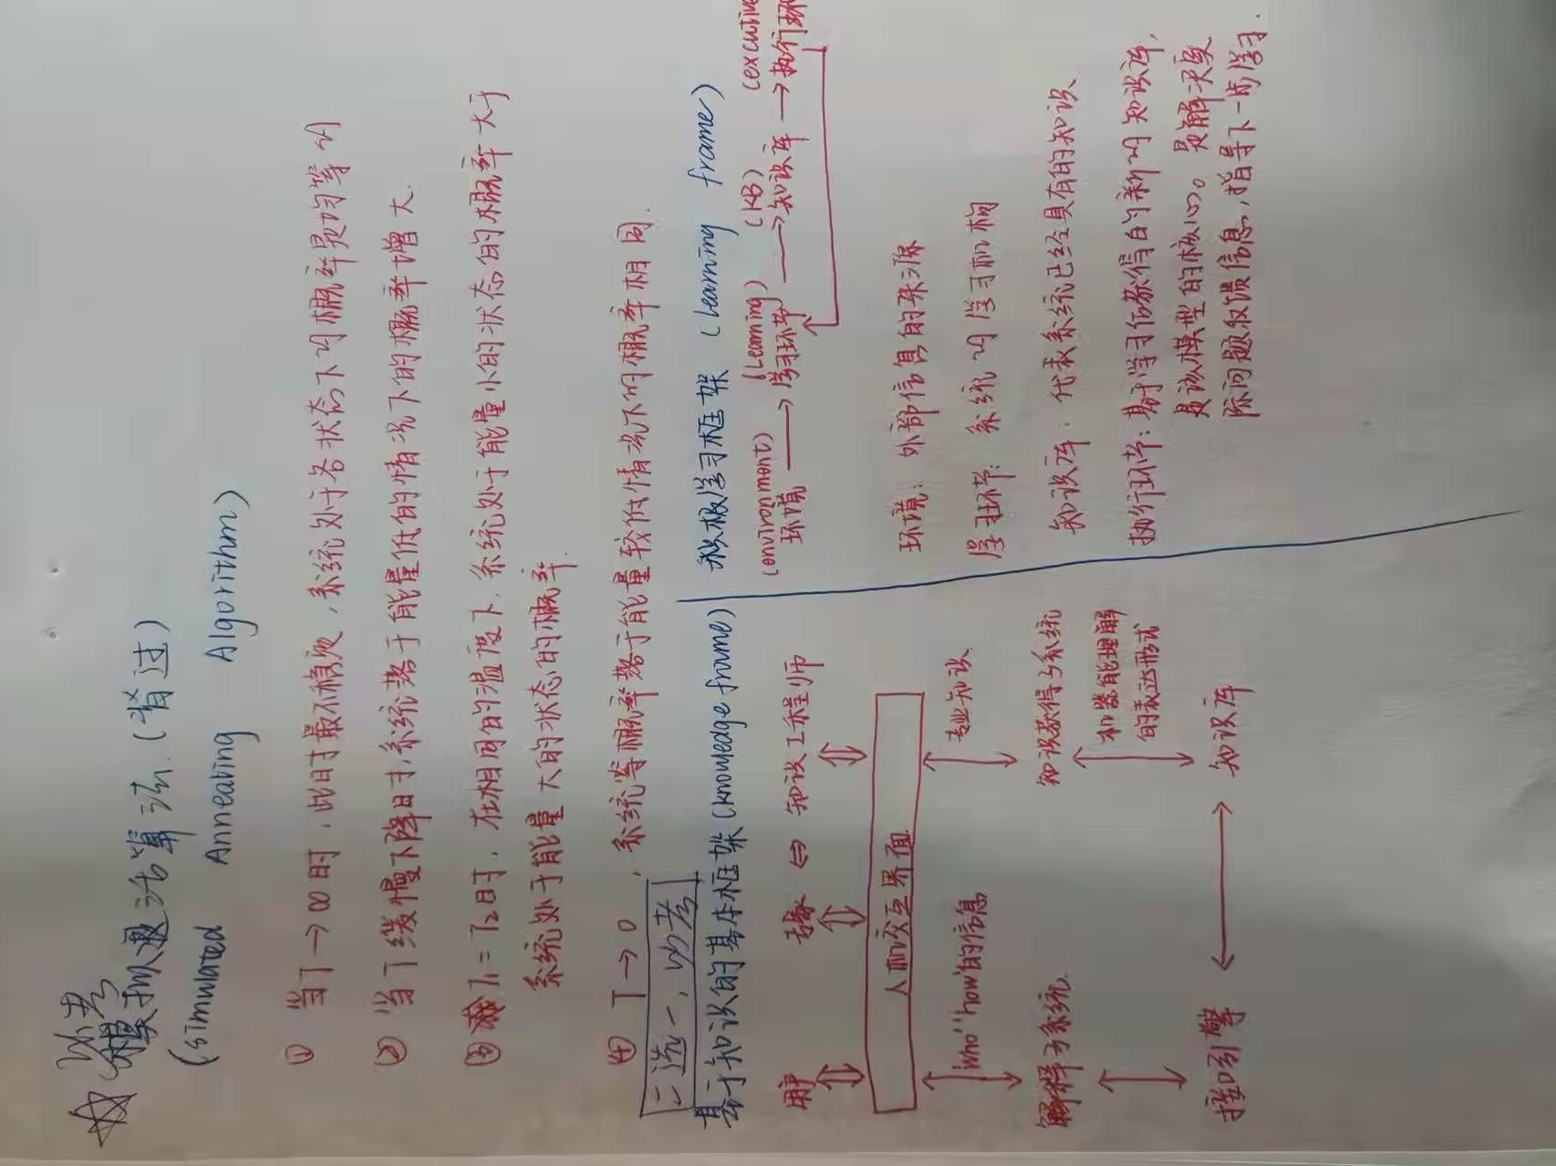

Slide 10
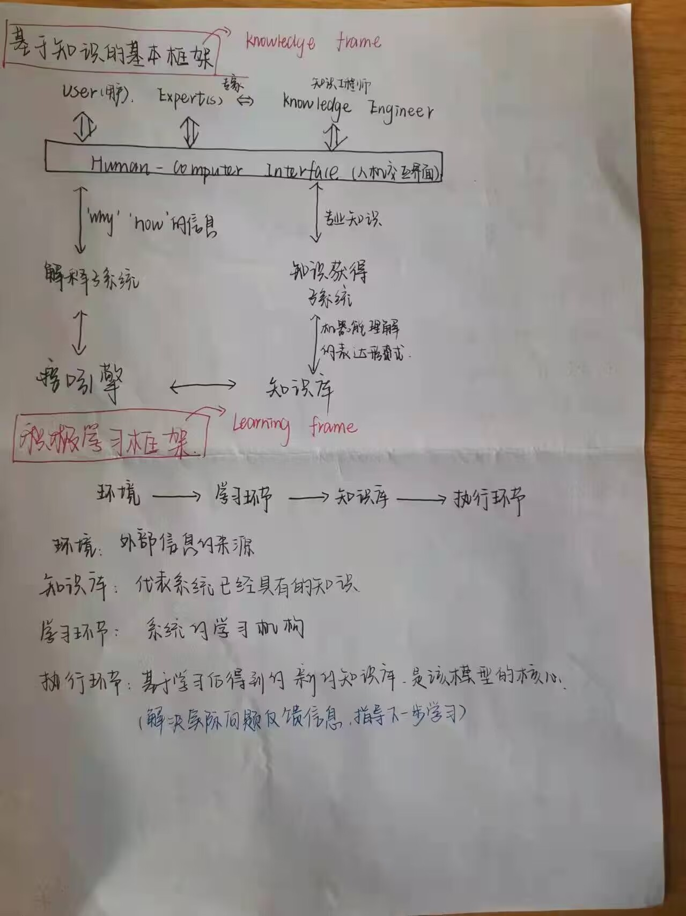

Slide 11
二(20)、Using Resolution Refutation to prove the following problem
Facts:
1) Whoever reads is literate.
2) Dolphins are not literate.
3) Some dolphins are intelligent.
Prove: Some who are intelligent cannot read.

Slide 12
三(20)、Consider the following properties and values of the building block world:
Color = { yellow, blue, green} Shape = {conical, spherical, rectangle}
Hardness = { hard, soft } Size = {large, small }
Learning the concept of "yellow" with the deletion candidate algorithm.
Examples:
1. (yellow, conical, soft, large, +) 2. (blue, rectangle, soft, small, -)
3. (yellow, spherical, soft, small, +) 4. (yellow, conical, hard, large, +).
5. (yellow, rectangle, soft, large, +) 6. (green, spherical, hard, large, -)

Slide 13
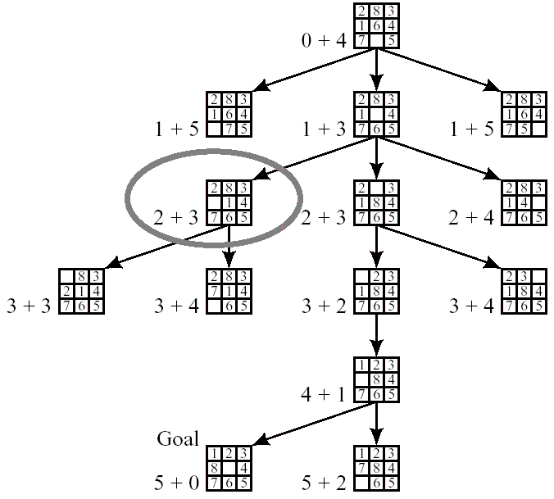
Using A * algorithm to convert the initial state to the target state.
The initial state The target state

Slide 14
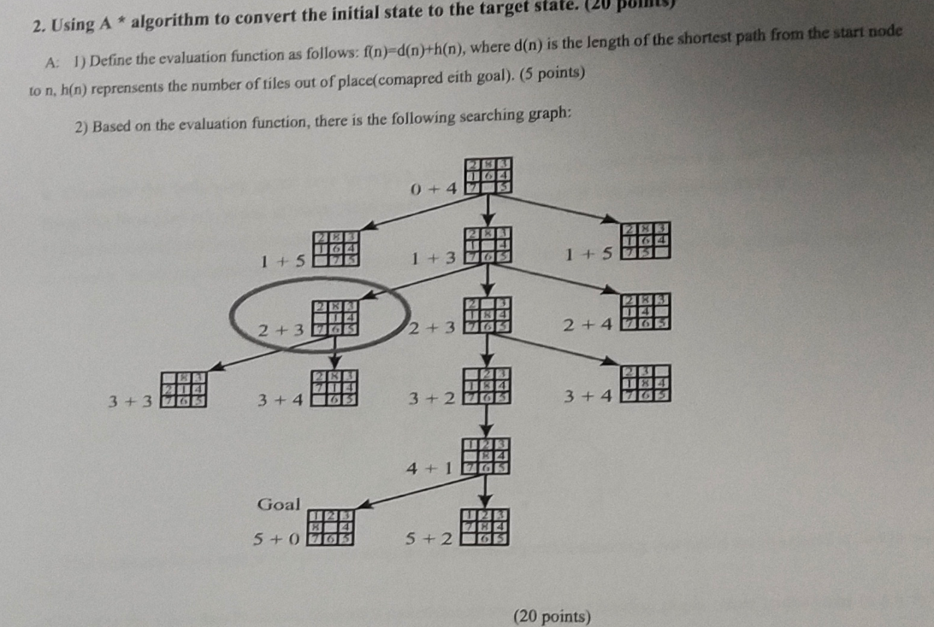

Slide 15
五(20)、Select your two favorite AI pieces, explain why you like them and how you apply them to solve specific problems.

Slide 16
1) 人工智能 2) 知识表示与获取 3) 启发式搜索
4) 专家系统 5) 常识知识

Slide 17
人工智能、机器学习、启发式修补、知识、知识获取
知识表示、信息、数据、深度学习、专家系统
盲目搜索、评估函数、完备性、可靠性、可采纳性
一致性、信息性、构造性方法 （约束传播）、函数优化
模拟退火算法、基于知识系统
对抗搜索/博弈搜索、极小极大化过程
命题演算、谓词演算、归结反演
常识知识表示、语义、语法、答案提取
置换、合一

Slide 18
Artificial Intelligence Deep Learning Constraint Propagation Predicate Calculus Machine Learningexpert Systems Repair Approach
Representing Commonsense Knowledge
Heuristic Search evaluation function function optimization Semantics Knowledge evaluation criteria
simulated Annealing syntax Knowledge Acquisition Consistency Knowledge Based Systems Completeness
Knowledge representation Admissibility adversarial search Soundness Information Informative Minimax Procedure Resolution Refutation Data Constructive method Propositional Calculus answer extraction
Substitution unification version space method

Slide 19
知识获取
函数优化
模拟退火算法
命题演算
谓词演算
归结反演
常识知识表示
语义、语法
置换、合一
约束传播 对抗搜索/博弈搜索
泛化、特化
推理、知识工程师、知识库、推理库、专家性
决策树

Slide 20
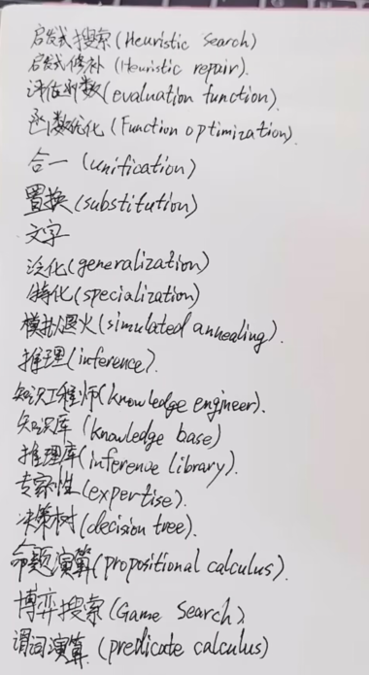
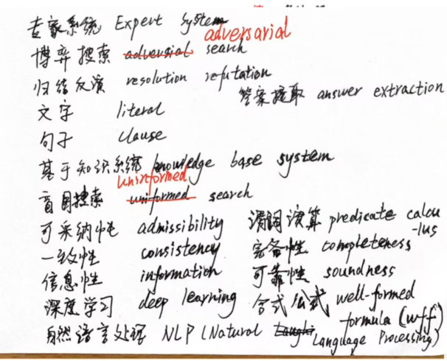

Slide 21
文字 (Literal)
子句（Clause）
答案提取
合式公式 （Well-Formed Formula）
自然语言处理
表示
构造性方法
归结反演
对抗搜索

Slide 22
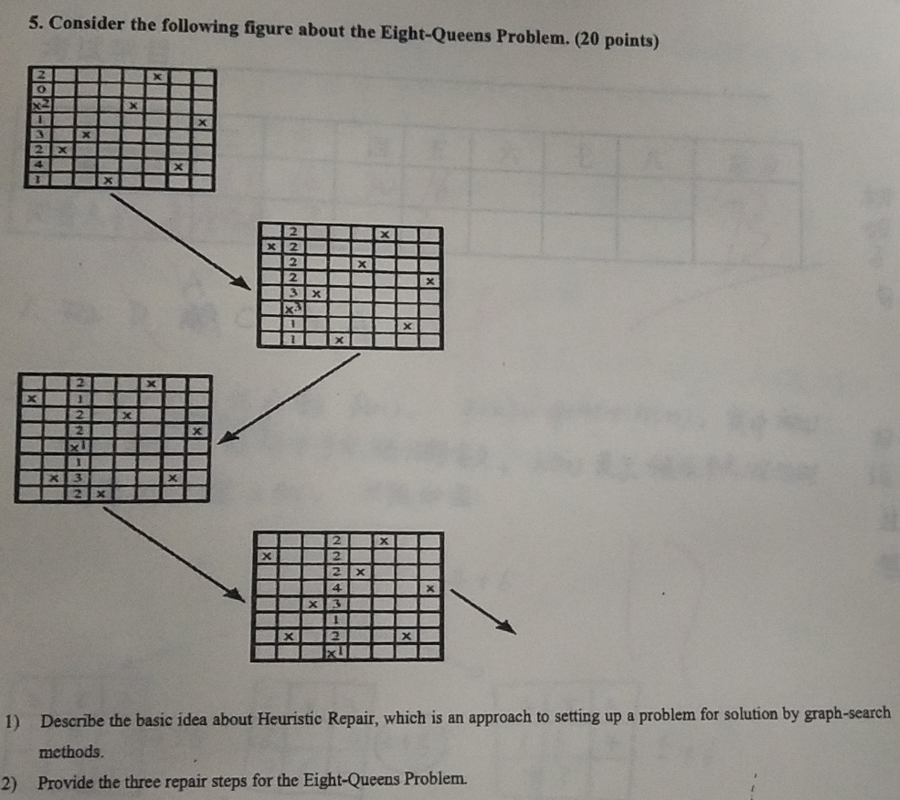
Min-conflicts heuristic: choose a value that results in a minimum number of conflicts with other variables.
选择一个与其他变量发生冲突次数最少的值。

Slide 23
Complete search of most game graphs is impossible.
注意： ξi 一定不能在τ I中出现。
Knowledge base of propositional calculus atoms
The atoms are called premisses instead of facts.

Slide 24
What is a learning system? 4 characteristics:
Purpose: must know what it is learning.
Structure: The knowledge representation and knowledge organization form can be modified and improved.
Effectiveness: The new knowledge acquired by the system must be beneficial to improving the behavior of the system.
Openness: the ability of a system to evolve over time in its actual use or interaction with its environment.

